Slide 1
Multidimensional Arrays
In C/C++, we can define multidimensional arrays in simple words as array of arrays.
Data in multidimensional arrays are stored in tabular form
Two – dimensional array is the simplest form of a multidimensional array.
data_type array_name[x][y];
We can declare a two dimensional integer array say ‘x’ of size 10,20 as y as:
int x[10][20];
Elements in two-dimensional arrays are commonly referred by x[i][j] where i is the row number and ‘j’ is the column number.
A two – dimensional array can be seen as a table with ‘x’ rows and ‘y’ columns where the row number ranges from 0 to (x-1) and column number ranges from 0 to (y-1).

Slide 2
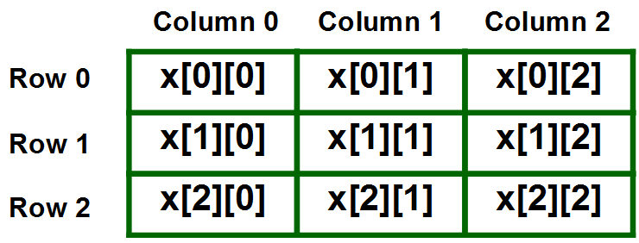
Multidimensional Arrays
A two – dimensional array ‘x’ with 3 rows and 3 columns is shown below:

Slide 3
Multidimensional Arrays
Initializing Two – Dimensional Arrays: There are two ways in which a Two-Dimensional array can be initialized.
int x[3][4] = {0, 1,2 ,3, 4 ,5 ,6, 7 ,8 ,9,10,11}
int x[3][4] = {{0,1,2,3}, {4,5,6,7}, {8,9,10,11}};
The above array have 3 rows and 4 columns. The elements in the braces from left to right are stored in the table
The elements will be filled in the array in the order, first 4 elements from the left in first row, next 4 elements in second row and so on.

Slide 4
Accessing Elements of Two-Dimensional Arrays:
Elements in Two-Dimensional arrays are accessed using the row indexes and column indexes.
int x[2][1];
The above example represents the element present in third row and second column.

Slide 5
int main()
{
// an array with 3 rows and 2 columns.
int x[3][2] = {{0,1}, {2,3}, {4,5}};
// output each array element's value
for (int i = 0; i<3; i++){
for (int j = 0; j<2; j++){
cout<<"array[“<<i<<“]”<<“[“ <<j<<“]=“ <<x[i][j]);
return 0;
}
arr[0][0] = 0
arr[0][1] = 1
arr[1][0] = 2
arr[1][1] = 3
arr[2][0] = 4
arr[2][1] = 5

Slide 6
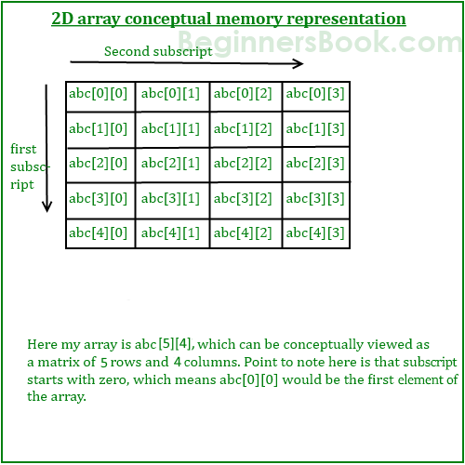
#include<stdio.h>
int main(){
/* 2D array declaration*/
int abc[5][4];
/*Counter variables for the loop*/
int i, j;
for(i=0; i<5; i++) {
for(j=0;j<4;j++) {
cout<<“Enter value for abc[“<<i<<“][“<<j<<“]:";
cin>>abc[i][j];
}
}
return 0;
}

Slide 7
Write a program in C to search an element in a row wise and column wise sorted matrix.

